Slide 1

Project Title: Contract Monthly Claim System (CMCS)
Kundai Makuzha ST10251297
Module: PROG6212 - Programming 2B
Part 3: Automation & Enhancement

Slide 2
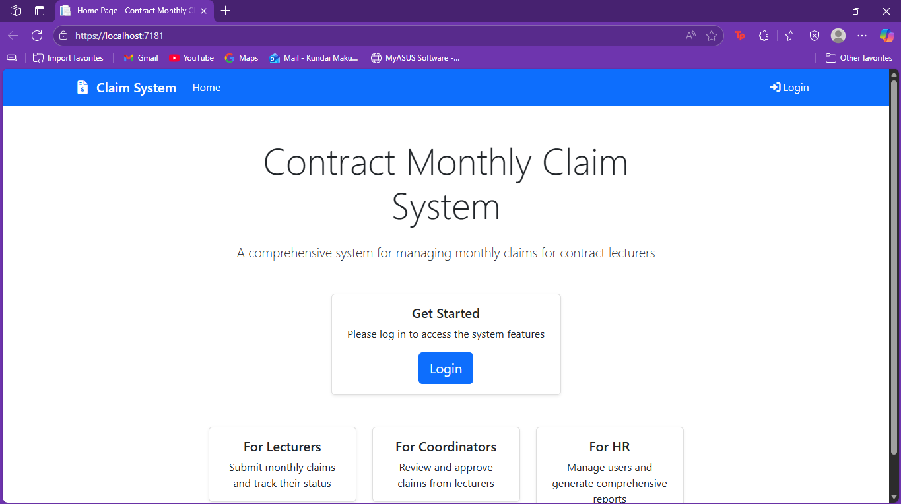
. Project Overview & Part 3 Objectives
System Recap:
.NET web application for contractor lecturers
Streamlines monthly claim submission and approval
Multi-role system (Lecturer, Coordinator, Manager, HR)
Part 3 Core Objectives:
✅ Implement HR "Super User" role
✅ Add login/authentication system
✅ Automate calculations & validations
✅ Enhance security with role-based access
✅ Generate reports & invoices
✅ Address all Part 2 feedback
”
-

Slide 3
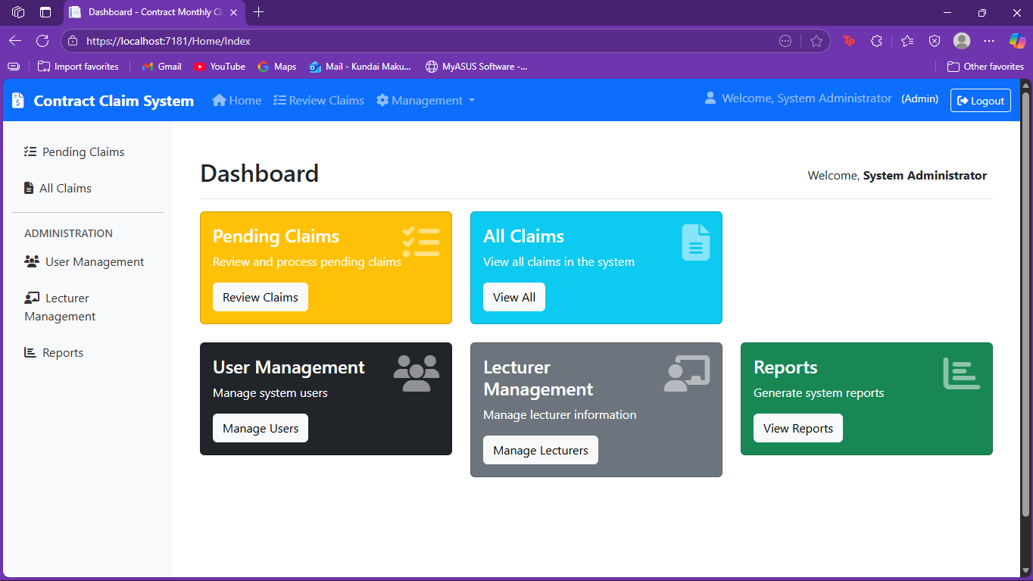
Responding to Part 1 Feedback
Part 1 Feedback | Part 3 Implementation
Missing Coordinator/Manager entities in UML | Added ApplicationUser inheritance with role separation
Unrealistic 21-hour project timeline | Implemented proper sprint planning with 45+ hours
Incomplete database design | Enhanced with Identity tables and user relationships

Slide 4
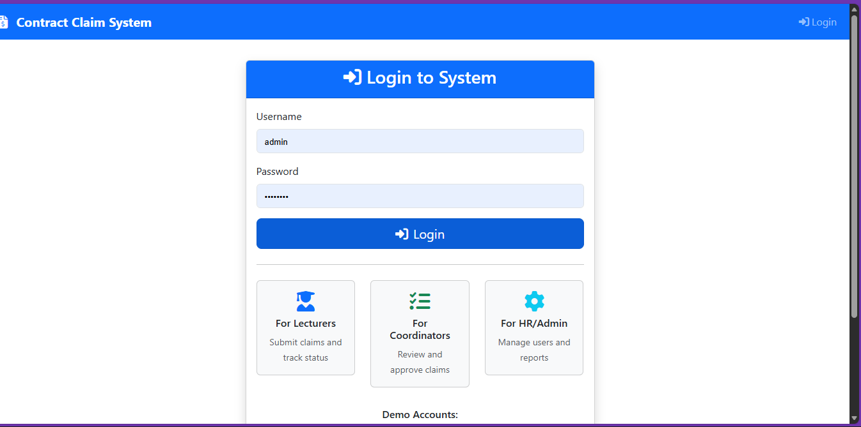
Responding to Part 2 Feedback - Major Issues Fixed
Part 2 Issue | Solution Implemented
No login system | ASP.NET Identity with role-based authentication
Manual rate entry | Hourly rate pulled from HR-set user profile
No document viewing | Secure document download functionality
Poor error handling | Comprehensive validation & user-friendly error messages
No unit tests | xUnit tests covering key functionalities

Slide 5
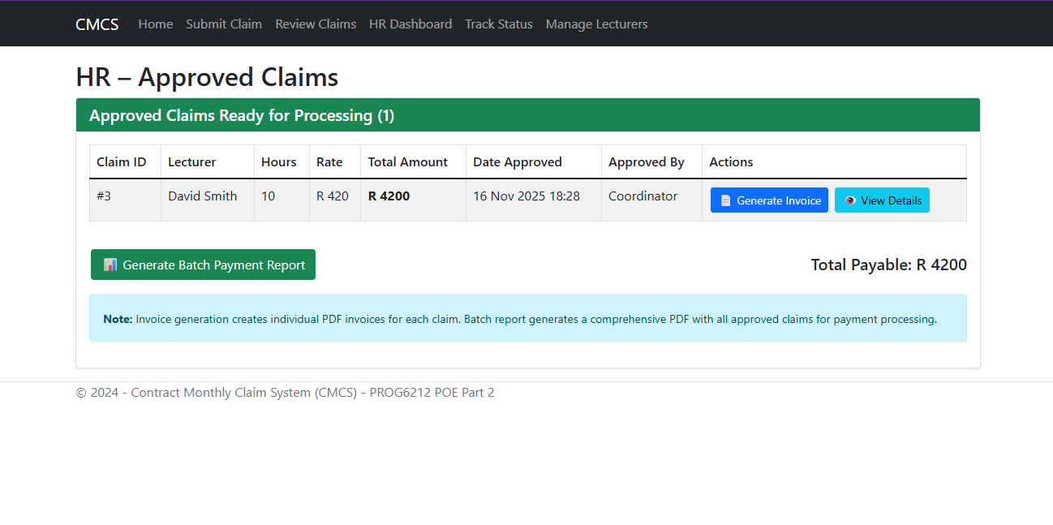
Key Feature 1 - HR Super User
Automation & Management:
User Management: Full CRUD operations for all users
Profile Setup: HR sets all user details (name, email, hourly rate)
Report Generation: LINQ queries for claim reports
PDF Export: Automated invoice generation

Slide 6
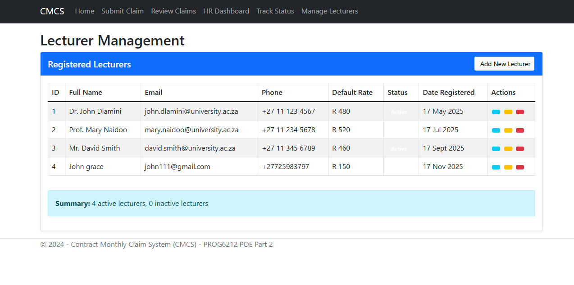
Feature 2 - Lecturer Automation
Enhanced Claim Submission:
Auto-Population: Name & rate from user profile
Real-time Calculation: JavaScript auto-calculation
Validation: Server-side hour limits (max 180 hours/month)
Document Upload: Secure file storage with view access
Lecturer claim form showing auto-calculation, validation errors

Slide 7
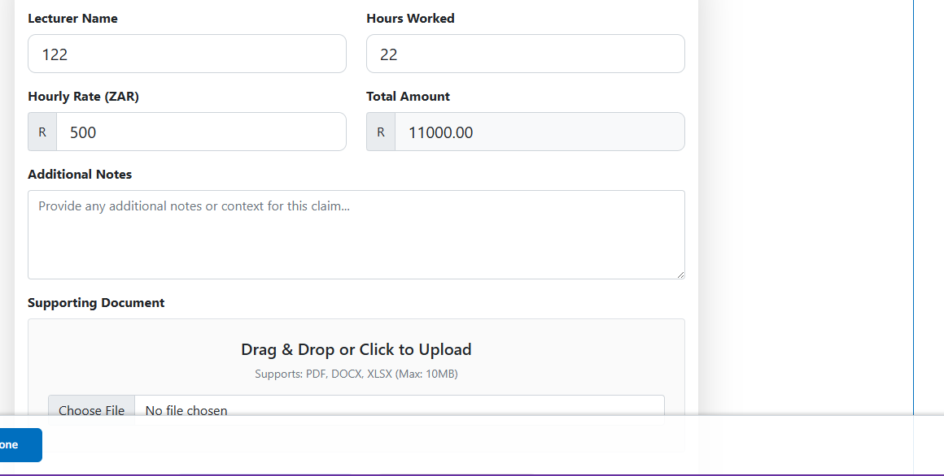
Enhanced Approval Workflow
Separate Coordinator & Manager Views:
Dual Approval: Both roles must approve claims
Document Access: View supporting documents before approval
Status Tracking: Real-time status updates
Security: Role-specific authorization

Slide 8
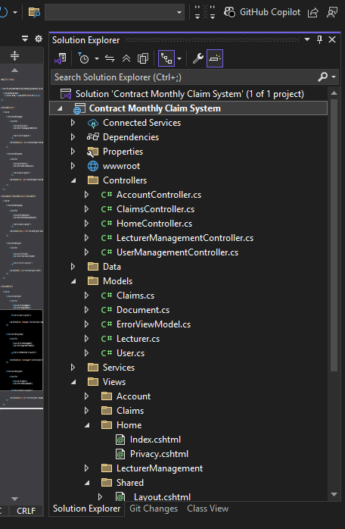
Technical Architecture
Technology Stack:
Backend: ASP.NET Core MVC, C#
Database: Entity Framework Core with SQL Server
Authentication: ASP.NET Identity
Frontend: Razor Pages, JavaScript/jQuery, Bootstrap
Reporting: QuestPDF for PDF generation

Slide 9
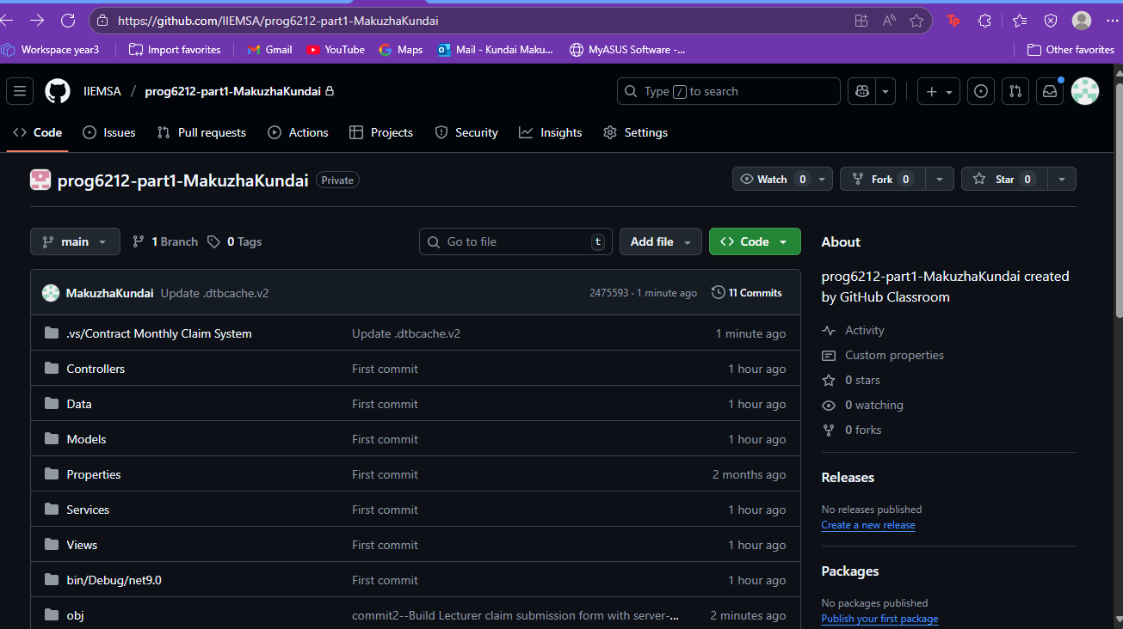
: Version Control - GitHub Commits
Improved Commit Practice:
Frequency: commits for Part 3
Descriptive Messages: Clear, action-oriented commits
Feature-based: Logical commit grouping

